Slide 1
business intelligence 381 G. Mudare

Slide 2
Connecting to Data Sources

Slide 3
Data Sources
The number of data sources to which you can connect is so numerous, we cannot cover them comprehensively.
We will be connecting to a variety of different types of data, to give you an idea how data connections take place in Power BI; and how easy it is to make these connections, and to apply transformation rules to the data being imported
The data sources are organized into the following categories:
File - Excel Workbook, Text/CSV, XML, JSON, etc.
Database
Power Platform
Azure
Online Services
Other – Web, SharePoint lists, Active Directory, Microsoft Exchange, Hadoop File (HDFS), etc.

Slide 4
Get data from files
Organizations often export and store data in files.
A flat file is a type of file that has only one data table and every row of data is in the same structure. E.g., csv, txt
Another type of file would be the output files from different applications, like Microsoft Excel workbooks (.xlsx).
Your files might exist in one of the following locations:
Local file
OneDrive for Business
OneDrive – Personal
SharePoint - Team Sites

Slide 5
Connecting to a CSV file
CSV (Comma Separated Values) is a standard generated by many systems and many software packages, as a medium for exporting report data.
To connect to a CSV source, in the Home Tab of the Ribbon, click on
Get Data > Text/CSV;
Then, browse for the required text file.

Slide 6
Connecting to a CSV file
Connect the file called “London.csv “.
Display a preview of the data which the file contains
Check if column headings have been recognized, and datatypes easily recognised.
Check the three drop-down menus
Choose a different encoding from the first; the File Origin drop-down menu.
Specify a delimiter using the options in the delimiter drop-down menu.
Check Data Type Detection drop-down

Slide 7
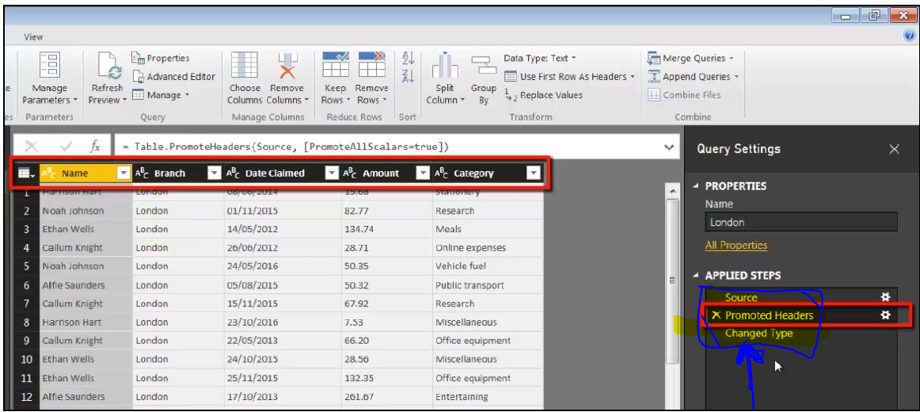
Query Editor
Query Editor is a separate application which runs inside Power BI Desktop
The Query Editor was originally known as Power Query.
Query Editor uses a language called M (M for mashup) to perform transformations on data as it is being imported.
Commands in the Query Editor’s user-friendly interface allow you to create a series of transformational rules which will apply whenever you are connecting to a given data source.

Slide 8
Query Editor
The Rules are referred to as steps, and are listed in the Query Settings pane, on the right of the Query Editor window.
Look at the automatically generated three steps: Source, Promoted Headers and Changed Type.
Source is the specification of the physical location of the CSV file
Promoted Headers is the step whereby Power BI deduces that the first row within a dataset constitutes the column headers.
Changed Type step, Power BI examines the data in each of the columns and attempts to change it to the appropriate data type.
Text (indicated by the ABC icon
Decimal number (represented by 1.2

Slide 9
Closing and Reopening the Query Settings Pane
Query Settings is a pane or floating window; and you can close it at any time to give yourself a bit more room for your data transformation operations.
To make the Query Settings pane visible once more
Click on View > Query Settings

Slide 10
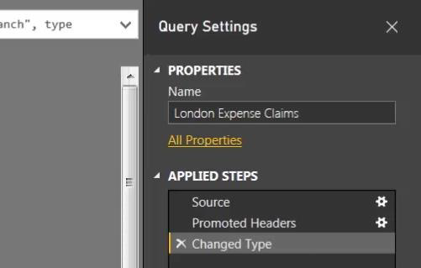
Renaming a Query
Renaming a Query can be done either in the Navigation pane or the Query Settings pane.
Simply double-click on the existing name, type a new one and press Enter.
(Right-click > Rename, or pressing F2 once the query is highlighted, can also be used.)

Slide 11
Using the Query Settings Buttons
The settings buttons (the cog icons) next to some of the steps.
If you click on one of these cogs, you can modify the settings associated with that step.
E.g., clicking on the cog icon next to the Source step displays a dialog allowing us to change the source file associated with the query.

Slide 12
Applying Changes Made in the Query Editor
To update Power BI Desktop and apply the changes made in the Query Editor, you can either click on Apply Changes; or, you can return to the Query Editor and click on File > Close & Apply.

Slide 13
Connecting to Excel Data
Excel is the lowest common denominator when it comes to Power BI data sources; since, pretty much everyone will have some data stored in Excel for at least some of their projects.

Slide 14
Connecting to Excel Data
Open the Excel file to work with
Choose “Excel objects.xlsx “ and edit the file in Microsoft Excel.
The Excel workbook contains a single worksheet called “Expenses”, which is ordinary Excel data consisting of columns and rows.

Slide 15
Connecting to Excel Data
To examine the other objects which Power BI will recognize, simply copy this worksheet and then modify the copy.

Slide 16
Connecting to Excel Data
The second type of Excel object recognized by Power BI is a table
Four ways to create a table in Excel:
Home > Format as Table,
Insert > Table,
Control-T
Control-L.
When the Create Table dialog appears, make sure the checkbox next to the option My table has headers is activated.
To name the table, use Table Tools > Design > Table Name.

Slide 17
Connecting to Excel Data
Tables are very much the preferred format when importing Excel data into Power BI. So, if you’re optimizing Excel data for Power BI, you should definitely consider converting the data into the table.
Create another copy of the “Expenses” worksheet (using Control-drag) and look at the third Excel object which Power BI recognizes: a named range.
create a named range which points to the entire dataset contained in your copied “Expenses (3)” worksheet.
Select all the data and then enter the name “Named_Range” in the name box in the top left of the screen, parallel with the formula bar.
Three types of object which Power BI Desktop will recognise:
ordinary worksheet data,
Excel tables
named ranges

Slide 18
Importing Excel Objects into Power BI
To import the data, we choose Home > Get Data > Excel; and then double-click on “Excel objects.xlsx”.
Power BI recognizes six objects in total:
the two tables named “Table3” and “Expenses_Table”,
the named range “Expenses_Named_Range”
the three worksheets (“Expenses Worksheet”, “Expenses Table Worksheet” and “Expenses Range Worksheet”).

Slide 19
Connecting to Excel Data
Recognizing the Icons
Different icons which are used to indicate tables, worksheets and named ranges:
The table icon has a blue bar at the top.
The worksheet icon has tiny sheet tabs in the bottom left.
The named range icon has a light blue shading in the middle of the icon.
Import all three types of Excel object, activate the checkboxes next to Expenses_Table, Expenses and Named_Range, then click the Edit button.

Slide 20
Connecting to the Folder
It is possible to use Power Query to combine multiple files with the same schema stored in a single folder into one table.
For example, each month you want to combine budget workbooks from multiple departments, where the columns are the same, but the number of rows and values differ in each workbook.
Each file should have the same schema with consistent column headers, data types, and number of columns.
Power Query automatically creates queries to consolidate the data from each file into a worksheet.

Slide 21
Connecting to the Folder
Open Power BI Desktop; and, in a blank file, click on Get Data > More > Folder.
click the Browse button and specify the path to the “All Data” folder.
When you click OK, the Navigator displays a list of all the files which have been found in the specified folder

Slide 22
Connecting to the Folder
At the bottom of the Navigator screen, click the Combine button to reveal a drop-down menu containing two options: Combine and Transform
and Combine and Load (which will load the data straight into the data model).
choose Combine and Transform.
click OK, to go to the Query Editor

Slide 23
Connecting to the Folder
The information is intact; and the Date Claimed and Amount columns have automatically been converted into date and decimal number
use the Change Type step.

Slide 24
Connecting to the Folder
The only thing which we do not want is the column which has automatically been created called “Source.Name”
Simply right-click on the column header and choose Remove.
removing a column implies that, when we connect to this folder, we do not need this particular column.
choose File > Close and Apply

Slide 25
Connecting to the Folder
Create a column chart which features the branch column on the axis and amount as the values.
On the chart, we can see the four branches (from Northern Ireland and Scotland) which we have imported so far.

Slide 26
Updating the Folder
If you connect to a folder, rather than a single file, whenever you refresh your report, Power BI will combine all of the files currently in the folder to produce a single table.
switch back to the exercises folder and move the “Wales” folder into the main “All branches” folder.

Slide 27
Connecting to the Folder
in Power BI Desktop, click on Home > Refresh, we can now see that the data from the Cardiff and Wrexham branches has been added to the dataset.

Slide 28
Exercise
What are the advantages and disadvantages of storing files locally compared to using a cloud option such as OneDrive or SharePoint Team Sites?
Find out how you can change the data source from one file or folder to another.

